Slide 1
Lab 4: Introduction to hardware description language (cont)

Slide 2
Assignments
Continous assignment:
- Continuous assignments continuously monitor the RHS (right – hand side) and update the LHS (left – hand side) immediately when the RHS change, does not introduce any timing delays.
Multiple continous assignment executes concurrently, order of statements is not important.
- Used outside always statement to design simple combinational circuit.
- Syntax: assign LHS = RHS;
Blocking assignment:
- Cause the RHS expression to be evaluated immediately, and the LHS variable is updated before moving to the next statement.
- Multiple blocking assignments are executed sequentially in the order they appear in the code, order of statements is important.
- Used inside always statement to design combinational circuit.
- Syntax: LHS = RHS;
Non – blocking assignment:
- Updating for the variables on the LHS occur at the end of current time step, typically on a clock edge.
- Multiple non-blocking assignments executes concurrently, order of statements is not important.
- Used inside always statement to design more complex sequential circuit.
- Syntax: LHS <= RHS;

Slide 3
Compare between types of assignments
 | Continous assignment | Blocking assignment | Non-blocking assignment
Update LHS to RHS | Immediately | Immediately | At the end of current time step, typically on a clock edge
Order of execution statements | Concurrently | In order | Concurrently
Using to design | Simple combinational circuit | Combinational circuit | Sequential circuit
Inside or outside always | Outside | Inside | Inside
Syntax | assign a = b | a = b | a <= b

Slide 4
Always statement
Syntax:
always @(sensitivity list)
statement;
- Statements in always statement is executed only when the event specified in sensitivity list occurs.
- always statement can be used to design flip-flop, latches or combinational circuit depend on the sensitivity list and statement.
- Types of always statement:
+ always @(sensitivity list) can be used to design sequential or combinational circuit based on sensitivity list
Ex: To design full adder: always@(a, b, cin)
To design D flip-flop: always@(posedge clk)
+ always_comb: is dedicated for designing combinational circuit; reevaluates the statements inside always_comb any time the signal on RHS of statement changes.
+ always_latch is dedicated for design latch
+ always_ff is dedicated for design flip flop

Slide 5
Example on fulladder
Example: design a fulladder using always_comb statement
Using always_comb and blocking assignment | Using continuous assignment
module fulladder(input logic A, B, Cin, output logic S, Cout); logic P, G; always_comb begin P = A ^ B; // blocking G = A & B; // blocking S = P ^ Cin; // blocking Cout = G | (P & Cin); // blocking end endmodule | module full_adder(input logic A,B,Cin, output logic S, Cout); logic P, G; assign P = A ^ B; assign G = A & B; assign S = P ^ Cin; assign Cout = G | (P & Cin); endmodule

Slide 6
Packed array and unpacked array
Feature | Packed array | Unpacked array
Declaration | Size/dimension to the left of variable name Ex: logic [3:0] data_bus; // 4 bits packed together | Size/dimension to the right of variable name Ex: logic flag[3:0]; // 4 independent 1-bit logic variables
Storage | Contiguous block of bits (compact in memory) | Independent elements (not contiguous in memory)
Usage | Represents multi-bit data like vectors, buses | Represents independent variables (like arrays)
Bitwise Operations | Supported (since elements are bits) | Not directly supported (need to access each element individually)
Arithmetic Operations | Supported (treats entire array as a number) | Not directly supported for the entire array
Example:
// Packed Array: Represents a 4-bit bus or vector
logic [3:0] data_bus; // 4 bits packed together
module inverter(input logic [3:0] a, output logic [3:0] b);
// Unpacked Array: Array of independent variables
logic flag[3:0]; // 4 independent 1-bit logic variables

Slide 7
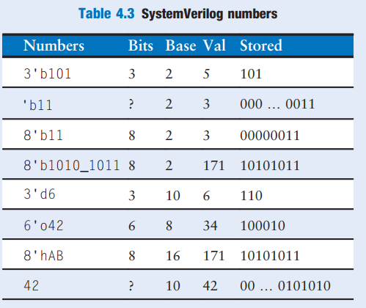
SystemVerilog numbers
- The format for declaring constants is N'Bvalue, where N is the
size in bits, B is a letter indicating the base, and value gives the
value.
Example, 9'h25 indicates a 9-bit number with avalue of
25(base 16) = 37(base 10) = 0001001012 (base 2).
- SystemVerilog supports 'b for binary, 'o for octal, 'd for decimal,
and ‘h for hexadecimal. If the base is omitted, it defaults
to decimal.

Slide 8
If-else statement
The syntax for an if-else statement in SystemVerilog is very similar to other programming languages
like C or Verilog. It is used to execute different blocks of code based on a conditional expression.
Syntax:
if (condition) begin
// Code to execute if condition is true
end else begin
// Code to execute if condition is false
end
Note: In SystemVerilog, if-else statement must appear inside always statement.

Slide 9
Case statement
Syntax:
case (expression)
value1: begin
// Code block to execute when expression == value1
//
end
value2: begin
// Code block to execute when expression == value2
//
end
// More value cases can be added here
default:
begin
// Code block to execute when expression doesn't match any value
// ...
end
endcase
Note: In SystemVerilog, case statement must appear inside always statement.

Slide 10
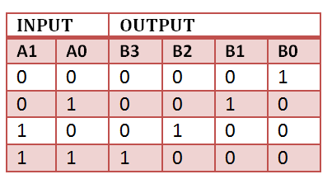
Exercise 1:
Design an 2-4 decoder using in SystemVerilog, simulate on ModelSim and test operations of design in STEP MAX10 board.
Hint: using always_comb statement, blocking assignment and if-else or case structure
Example: module decoder2_4 (input logic [1:0] A,
output logic [3:0] B);

Slide 11
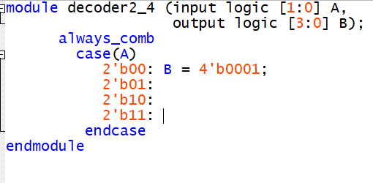
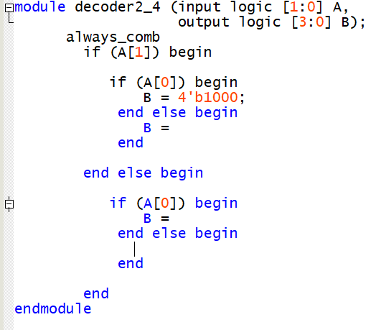
Exercise 1:
Design an 2-4 decoder using in SystemVerilog, simulate on ModelSim and test operations of design in STEP MAX10 board.
Hint: using always_comb statement, blocking assignment and if-else or case structure
Case statement | If-else statement

Slide 12
Exercise 2:
Design an ALU using in SystemVerilog, simulate on ModelSim and test operations of design in STEP MAX10 board.
Hint: using always_comb statement, blocking assignment and case structure
Opcode | Operation
000 | Add
001 | Substract
010 | And
011 | Or
100 | Xor
101 | Equal
Example: module ALU(input logic A, B,
input logic [2:0] opcode,
output logic out);

Slide 13
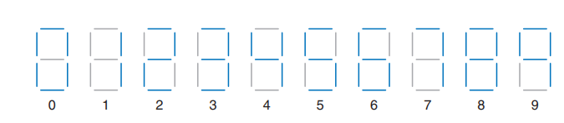
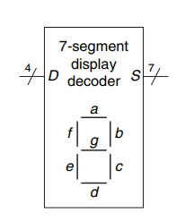
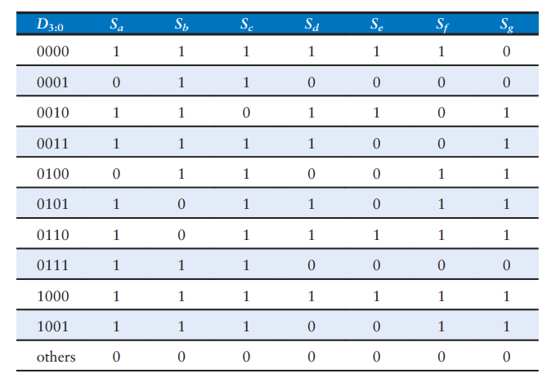
Exercise 3:
Design a seven segment decoder using always_comb statement and case structure in SystemVerilog, simulate on ModelSim and test operations of design in STEP MAX-10 board.
Hint: using always_comb statement and case structure

